Slide 1
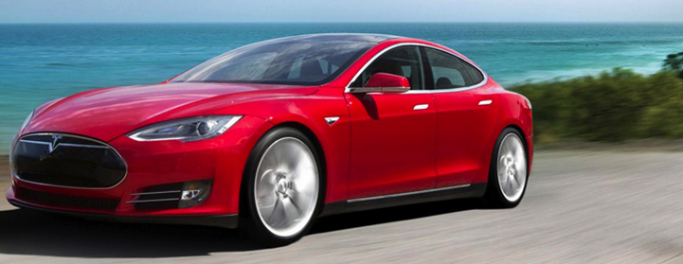
THE EVOLUTION OF THE CAR
Is the Connected Car the Next Digital Platform?
Providing in-depth insight, data, and analysis of everything digital.

Slide 2






Cars Have Evolved…

Slide 3
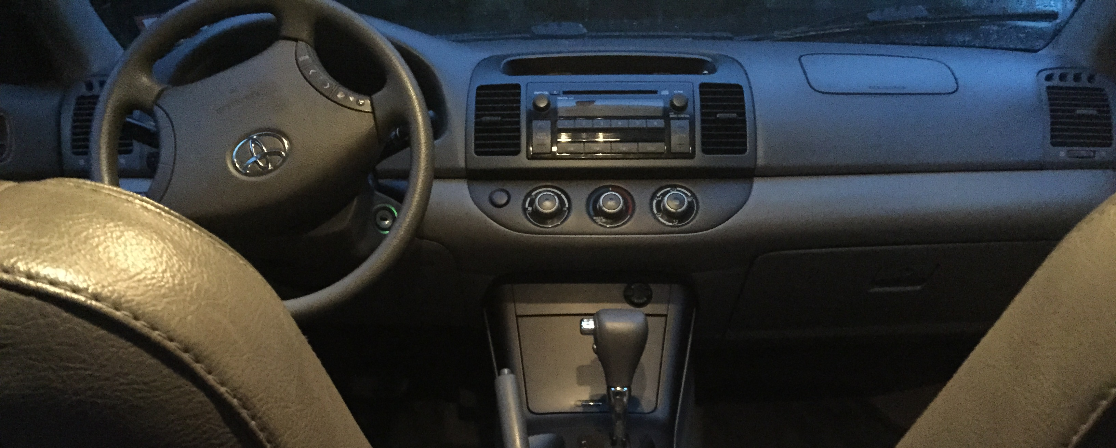
My 2005 Camry

Slide 4
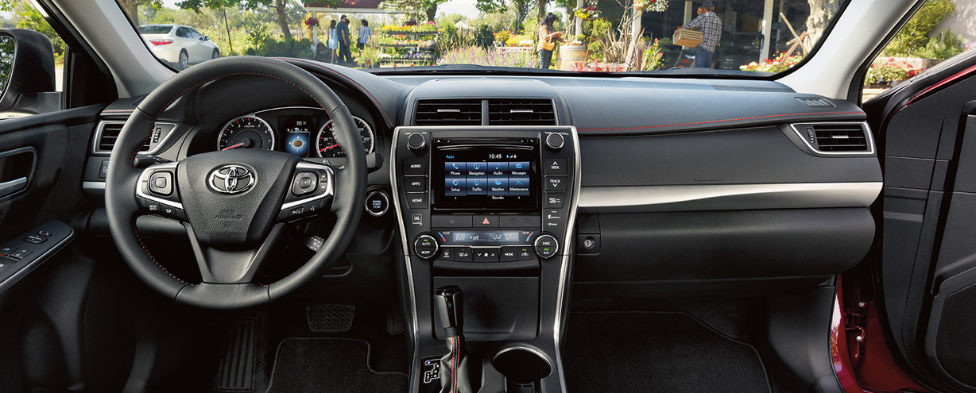
2016 toyota camry
Source: Toyota

Slide 5
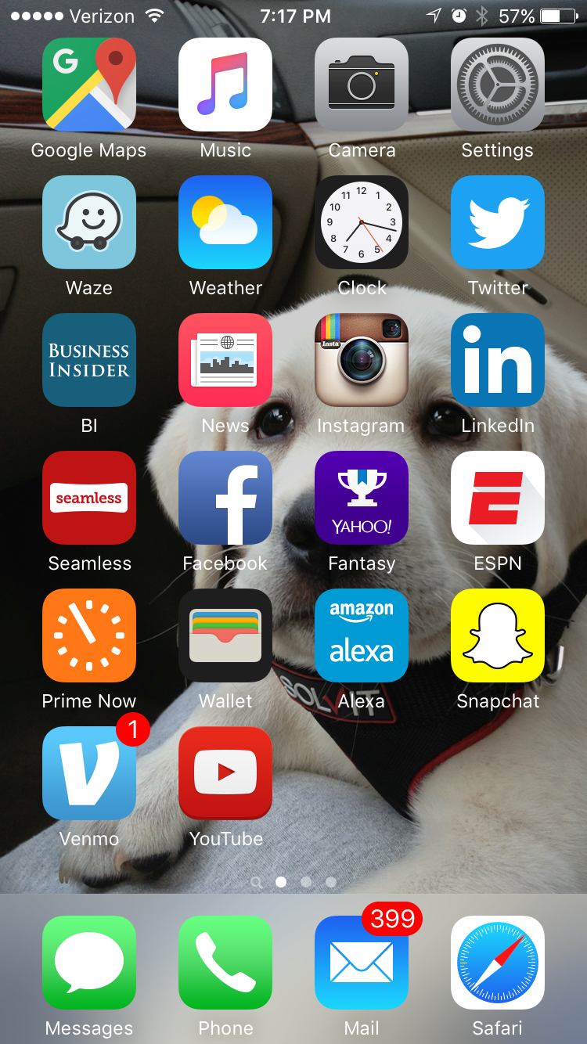
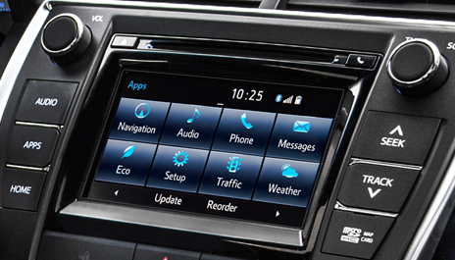
The car’s infotainment center is revolutionary
Vs.
Source: Toyota

Slide 6
APPS In the car Are HIGHLY DESIRED
Q: Which of the following services do you think is important for your passengers to access in the car?
Source: Accenture, 2014

Slide 7
In-Car Technology is becoming mandatory
Q: What has more influence over your car purchasing decision?
The car’s driving performance has the greatest impact
The in-car technology has the greatest influence
Source: Accenture, 2014; BI Intelligence, 2015

Slide 8
CONSUMERS ARE WILLING TO LEAVE AUTOMAKERS OVER THEIR TECH
Q: I would switch to another manufacturer if it was the only one offering a car with full access to the applications, data, and media. (Percentage who responded ‘Yes’)
Source: McKinsey, 2015

Slide 9
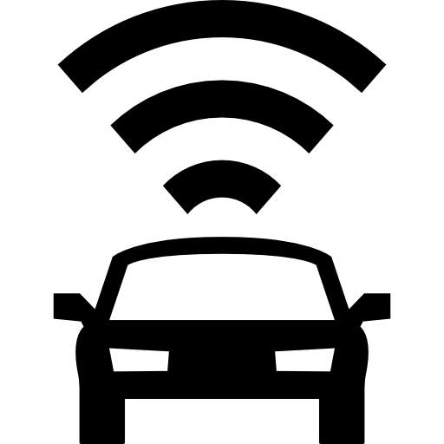
75% of new cars shipped in 2020 will be internet-connected
Global Connected Car Shipments As A Percentage Of Total Cars Shipped
Source: Scotiabank, BI Intelligence Estimates, 2015

Slide 10
Why are Automakers Connecting Cars?
How Automakers Benefit From Connecting Cars
Generating Data
Pushing Over-The-Air Updates
4
3
1
2
Improving Car Safety
Adding Products & Services

Slide 11
$15 billion will be generated by connected car entertainment in 2021
Estimated Global Connected Car Entertainment Market Potential
Source: Strategy&, BI Intelligence estimates, 2015

Slide 12



Americans spend more time in their car than on tablets
Average American Monthly Time Spend
Source: Comscore, 2015; Harvard Health Watch, 2007;
BI Intelligence estimates, 2015

Slide 13
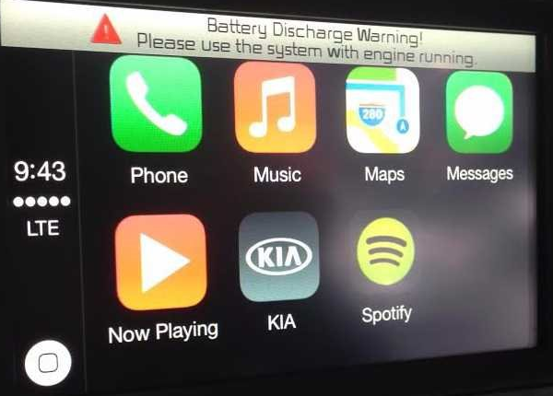
APPLE AND GOOGLE ARE ENTERING THE CAR MARKET
Source: BI Intelligence, 2015

Slide 14
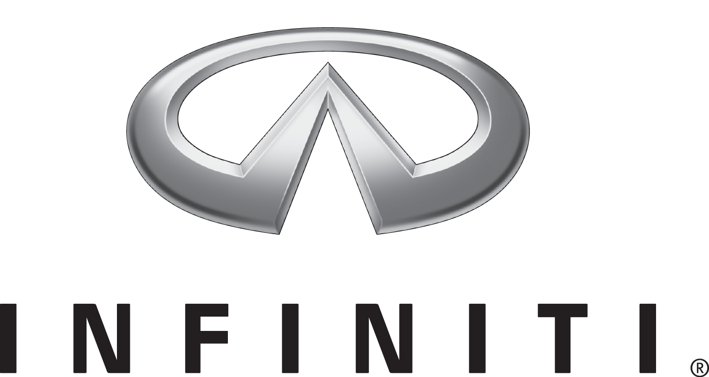





















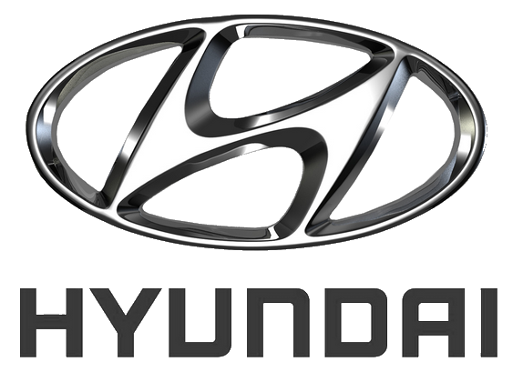


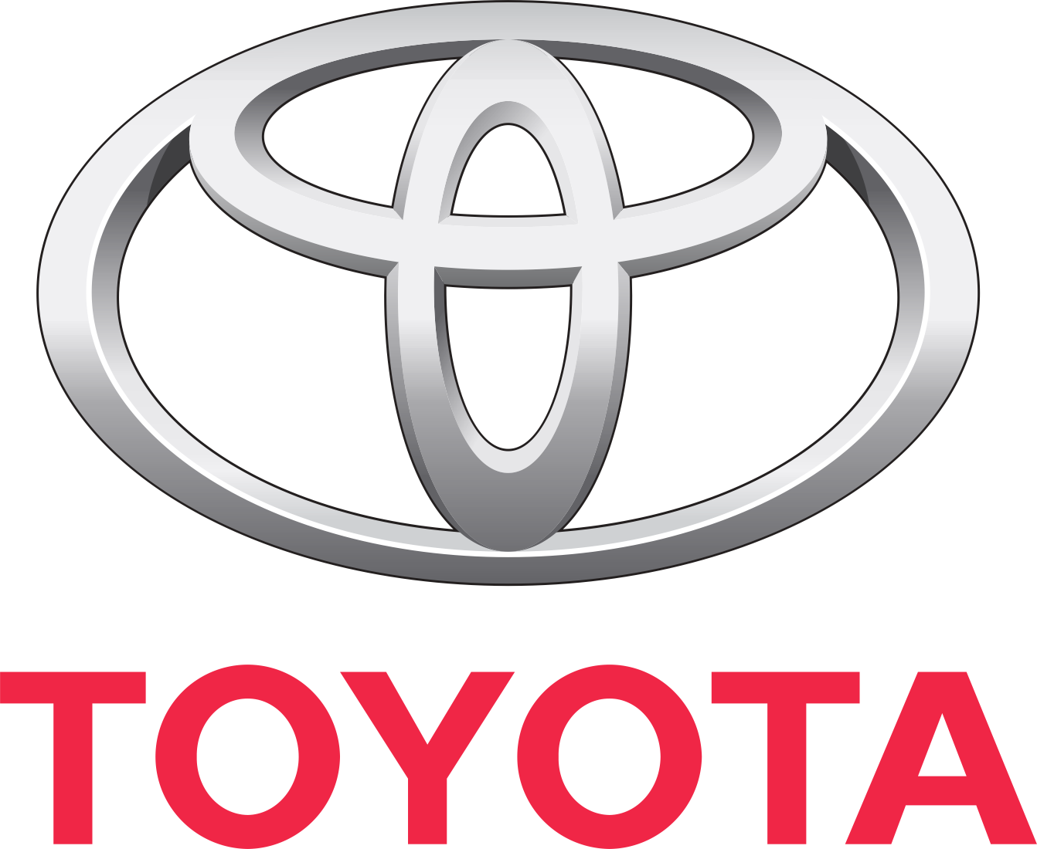





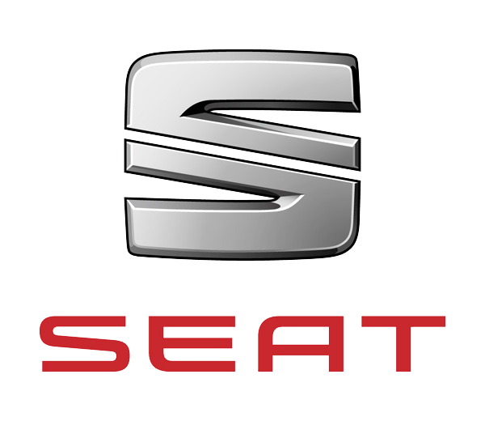




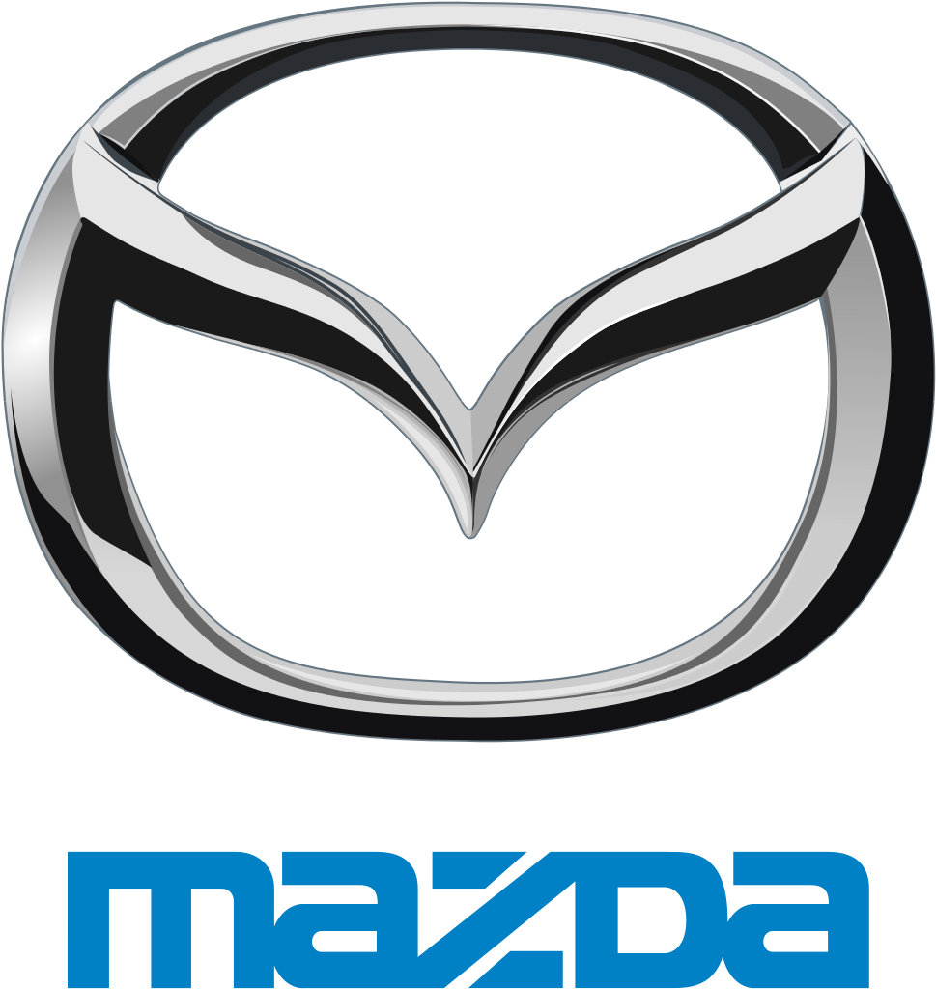








Very Few Automakers Are Exclusive With Android Auto Or Apple CarPlay
Source: Company Websites, Wikimedia

Slide 15
Q: How important is it for your car to have the same operating system in the dashboard as compared to your devices?
Consumers Want Their Mobile OS On Their Cars’ dashboardS
Source: Accenture, 2014

Slide 16

BUT AUTOMAKERS ARE RELUCTANT TO LET GOOGLE AND APPLE INTO THEIR CAR
Notes:
Transitional Slide

Slide 17
Why are Automakers Connecting Cars?
How Automakers Benefit From Connecting Cars
Generating Data
Pushing Over-The-Air Updates
4
3
1
2
Improving Car Safety
Adding Products & Services

Slide 18

CARS ARE BECOMING A NEW SOURCE OF DATA
Exabytes Of Data Produced By Global Connected Cars 1 Exabyte = 1 Billion Gigabytes

Slide 19




The tug of war over connected car data

Slide 20
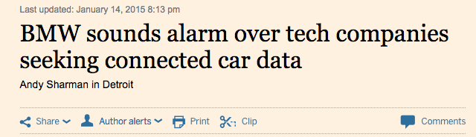

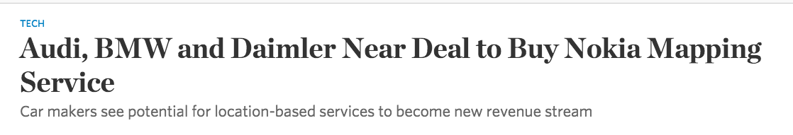

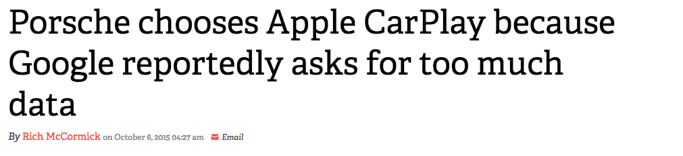

Source: Financial Times, The Verge, WSJ, 2015

Slide 21
Estimated Number Of Cars With Android Auto Vs. Apple CarPlay
AUTOMAKERS WILL EVENTUALLY GIVE IN TO THE CONSUMER DEMAND FOR CARPLAY AND ANDROID AUTO
Source: IHS, 2015

Slide 22
Thank you!
For more BI Intelligence content visit
intelligence.businessinsider.com

